Slide 1
UNDERSTANDING CARDINALITY IN
POWER BI
DIM
FACT
1
*

Slide 2
What is Cardinality?
Cardinality in Power BI refers to the type of relationship between two tables based on the uniqueness of values in related columns.
It defines how data from one table corresponds to data in another, affecting how Power BI joins and aggregates data.

Slide 3
Types of Cardinality in Power BI
Power BI supports four main types of cardinality:
One-to-One (1:1)
Each value in Table A matches exactly one value in Table B.
Used when both tables have unique identifiers.
Example: A table of Employees and a table of Employee Details where each employee appears only once.
One-to-Many (1:M) (Most Common)
Each value in Table A matches multiple values in Table B.
Example: A Customers table (one customer) related to an Orders table (multiple orders per customer).
Many-to-One (M:1)
Reverse of One-to-Many, where the lookup table is on the right.
Power BI automatically handles Many-to-One relationships as One-to-Many.
Many-to-Many (M:M)
Used when multiple values in Table A relate to multiple values in Table B.
Requires a bridge table or direct many-to-many relationships in Power BI.
Example: A Students table related to a Courses table (students enroll in multiple courses, and each course has multiple students).

Slide 4
Cardinality Settings
Why is Cardinality Important?
Cardinality in Power BI Relation-ship Settings
When defining relationships in Power BI, you also choose
Cross-filter direction (Single vs. Both)
Active vs. Inactive relationships (Only one relationship is active at a time)
Affects data modeling and query performance.
Determines filter propagation in relationships.
Impacts how aggregations and measures behave.

Slide 5
Best Practices
Prefer One-to-Many relationships where possible.
Optimize Many-to-Many relationships using bridge tables.
Check data granularity to ensure relationships are correct.
Use correct cross-filtering to control data flow.
Ensure primary and foreign keys have unique values to avoid ambiguous relationships.

Slide 6
When to Use a One-to-One (1:1)
A One-to-One (1:1) relationship is used when each value in a column of Table A matches exactly one value in a column of Table B and vice versa.
It is less common in Power BI because, usually, data modeling benefits from One-to-Many (1:M) relationships. However, One-to-One can be useful in specific cases.

Slide 7
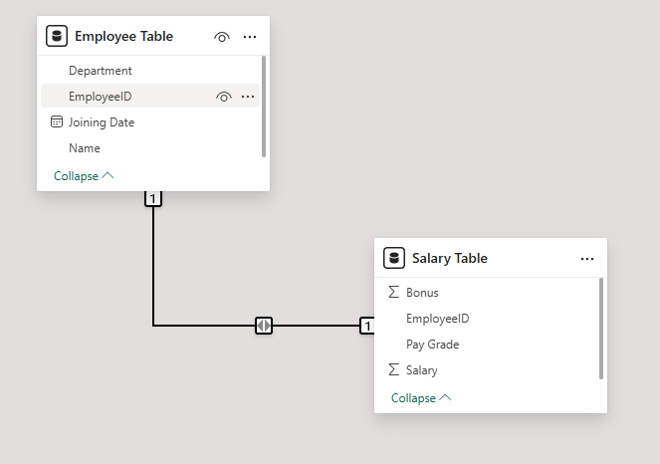
Example – Data model

Slide 8
Why Use a One-to-One Relationship
Security & Data Separation:
If salary data is confidential, it can be stored in a separate table with restricted access.
Better Performance & Data Organization:
Splitting large tables can improve Power BI performance.
Keeping sensitive information separate makes queries faster.
Avoiding Unnecessary Data Duplication:
If all fields were combined in one table, it could make data management complex.
A One-to-One relation allows Power BI to retrieve salary data only when needed.

Slide 9
When to Use a One-to-One (1:1)
A One-to-One (1:1) relationship
is used when each value in a column of Table A matches exactly one value in a column of Table B and vice versa.
It is less common in Power BI because, usually, data modeling benefits from One-to-Many (1:M) relationships.
However, One-to-One can be useful in specific cases.

Slide 10
Practical Example:
Employee & Employee Salary Details
Scenario
A company maintains employee data in two separate tables:
Employees Table (General Employee Information)
Salaries Table (Salary Details)
Each employee has a unique Employee ID, and each salary record also corresponds only to one employee. Since no employee has multiple salary records, this is a One-to-One relationship.

Slide 11
Table Structure
Employees Table
Employee ID | Name | Department | Joining Date
101 | John Doe | IT | 01-Jan-22
102 | Jane Smith | HR | 15-Feb-22
103 | Bob Johnson | Finance | 10-Mar-22
Salary Table
Employee ID | Salary | Bonus | Pay Grade
101 | 80,000 | 5,000 | A
102 | 70,000 | 4,000 | B
103 | 90,000 | 6,000 | A+

Slide 12
Why Use a One-to-One Relationship Here?
Security & Data Separation:
If salary data is confidential, it can be stored in a separate table with restricted access.
Better Performance & Data Organization:
Splitting large tables can improve Power BI performance.
Keeping sensitive information separate makes queries faster.
Avoiding Unnecessary Data Duplication:
If all fields were combined in one table, it could make data management complex.
A One-to-One relation allows Power BI to retrieve salary data only when needed.

